Slide 1

Handwritten Digit Recognition Using CNN
By Dev Sharma

Slide 2
Introduction
What is Handwritten Digit Recognition?
Real-World Applications
Banking: Automated cheque processing and form digitisation
Handwritten digit recognition is the automated process of identifying and classifying numerical digits (0–9) from images of handwritten text. This computer vision task enables machines to interpret human writing with remarkable accuracy.
Postal services: Rapid sorting of postcodes and addresses
Healthcare: Digital patient record management
Education: Automated marking and assessment systems
Why Automation Matters
Automating digit recognition eliminates manual data entry, reduces errors, and accelerates processing times across numerous industries.

Slide 3




Project Objective & Dataset
Input
28×28 pixel greyscale images of handwritten digits
Process
Convolutional Neural Network analyses patterns and features
Output
Predicted digit classification (0–9) with confidence scores
The MNIST Dataset
Dataset Split
The Modified National Institute of Standards and Technology database contains 70,000 images of handwritten digits. Each image is a 28×28 pixel greyscale representation, carefully normalised and centred.
Training set: 60,000 images
Testing set: 10,000 images
Preprocessing: Pixel normalisation (0–1 range)

Slide 4


Understanding Convolutional Neural Networks
01
Convolutional Layers
Extract spatial features using filters that detect edges, curves, and patterns across the image
02
Activation Functions
ReLU (Rectified Linear Unit) introduces non-linearity, enabling the network to learn complex patterns
03
Pooling Layers
Reduce dimensionality whilst retaining crucial features, making the model more efficient and robust
04
Fully Connected Layers
Combine extracted features to make final classification decisions with softmax activation
Why CNNs Excel at Image Classification: Unlike traditional neural networks, CNNs preserve spatial relationships between pixels, automatically learning hierarchical feature representations from raw image data without manual feature engineering.

Slide 5
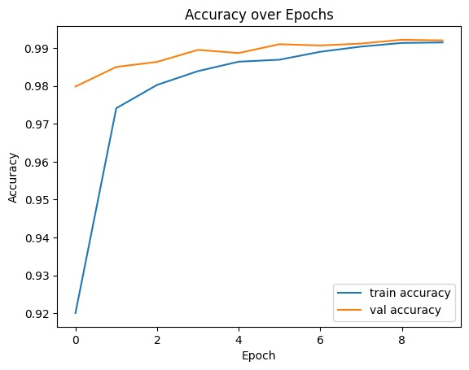
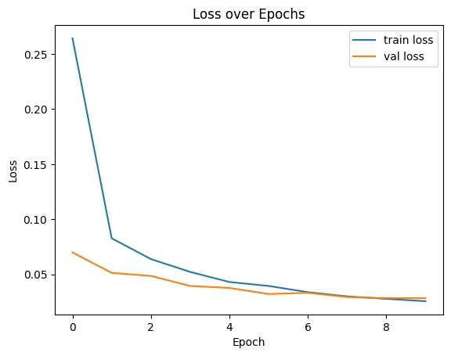
Model Architecture & Training
Network Architecture
Training Configuration
Conv2D + ReLU
Hyperparameters
Feature extraction
Epochs: 10–15
Batch size: 128
MaxPooling
Optimiser: Adam
Dimension reduction
Learning rate: 0.001
Flatten
Loss Function
Vector conversion
Categorical cross-entropy measures prediction error, guiding weight adjustments during backpropagation
Dense + Softmax
Classification
Layer Purposes
Conv2D: Applies learnable filters to detect features
MaxPooling: Downsamples feature maps
Flatten: Converts 2D features to 1D vector
Dense: Fully connected classification layer
Softmax: Produces probability distribution
98%
95%
Test Accuracy
Custom Input
Achieved on MNIST dataset
Accuracy on exclusive handwritten samples

Slide 6




Conclusion & Future Scope
Project Achievements
Future Enhancements
This project successfully demonstrates how Convolutional Neural Networks can accurately recognise handwritten digits with minimal preprocessing. The model achieves 98% accuracy on standard datasets and maintains robust performance on custom inputs.
Expanded Training Data
Include diverse handwriting styles and data augmentation techniques
Key Learnings
Deeper Architecture
CNNs automatically extract hierarchical visual features
Implement residual connections and attention mechanisms
Proper dataset preprocessing significantly improves accuracy
Real-Time Deployment
Architecture design impacts model performance and efficiency
Create web application with live handwriting recognition capabilities
"This CNN-based approach transforms handwritten digit recognition from a manual, error-prone task into an automated, highly accurate process with applications across banking, postal services, and digital transformation initiatives."

